Slide 1

Unit 4: Lesson 3 Bristol’s Upfest

Slide 2
Task 1: Is there a lot of graffiti in your town? What are the most common motifs?
Task 2: Use a dictionary to translate the words into Croatian.
živahan
marka
sudjelovati
platno
neravnopravnost
kojim dominiraju muškarci
vandalizam
kazna
škrabotina
stražnja uličica

Slide 3
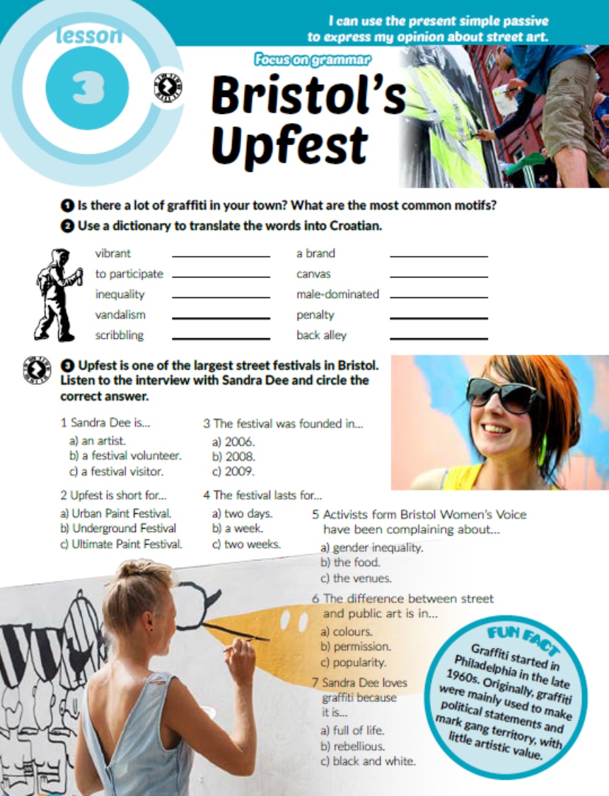
Task 3: Listen to the interview and circle the correct answer.
https://www.e-sfera.hr/dodatni-digitalni-sadrzaji/2b97e26e-4add-434f-b70d-ffb603999aff/

Slide 4
Task 4: Complete the sentences with the correct verb forms. Then listen to the interview again and check.
https://www.e-sfera.hr/dodatni-digitalni-sadrzaji/2b97e26e-4add-434f-b70d-ffb603999aff/
is known
is held
are expected
are placed
are reserved
are painted
is needed
are considered
are approved

Slide 5
Zapiši u bilježnicu:
Passive voice
Passive form: to be + past participle
Pasiv koristimo kada je subjekt nepoznat ili nevažan. Objekt aktivne rečenice time postaje subjekt pasivne rečenice.
Active: They make best sandwiches here.
Passive: Best sandwiches are made here.
Present simple passive
Form: am/is/are + past participle
Groceries are bought in supermarket.

Slide 6
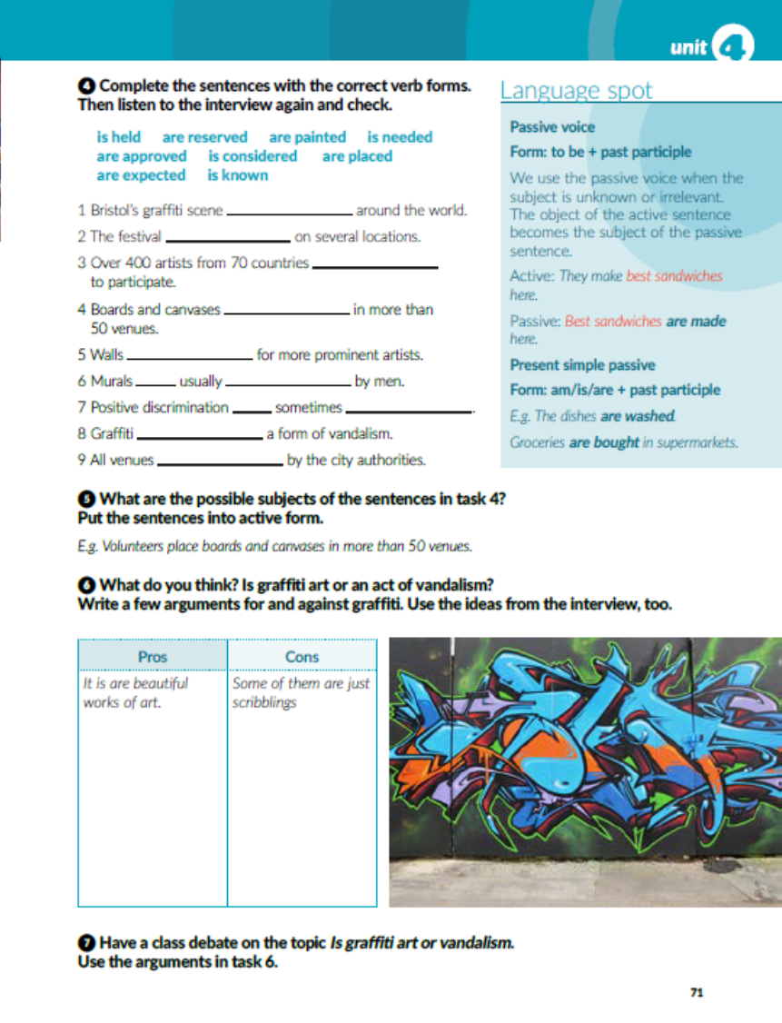
Task 6: What do you think? Is graffiti art or an act of vandalism? Write a few arguments for and against grafiti.

Slide 7
workbook, page 73
Task 1: Complete the text with the words from the box.
vibrant
brand
participate
canvases
male-dominated
discrimination
vandalism
penalty
venues

Slide 8
Task 2: Complete the text with the present simple passive form of the verbs in brackets.
is situated
are spoken
is considered
are ridden
is known
is visited
is allowed
is encouraged
are flown
are lit

Slide 9
Task 3: Active or passive? Circle the correct form..

Slide 10
Task 4: Rewrite the sentences in the passive voice.
New theories are tested in laboratories.
Robots are used to speed up production.
Fridges are used to keep our food fresh.
Cocoa beans are grown in South America.
The Internet is used to find useful information.
Warm clothes are worn in winter.

Slide 11

PLAY AND LEARN!
https://www.e-sfera.hr/dodatni-digitalni-sadrzaji/2b97e26e-4add-434f-b70d-ffb603999aff/

